Slide 1
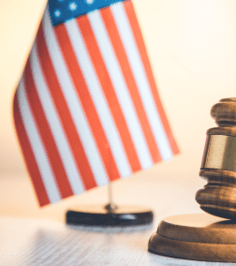
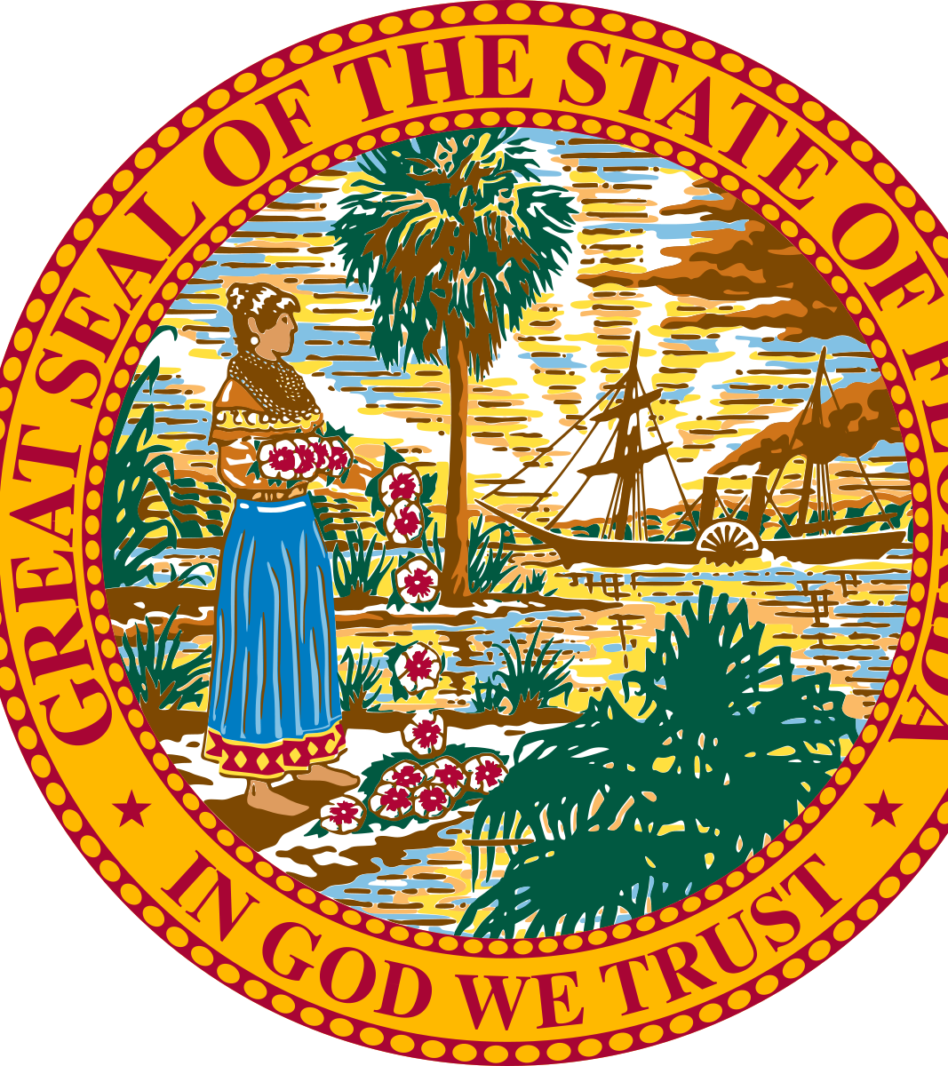
Conservation lands
SB546, HB441

Slide 2
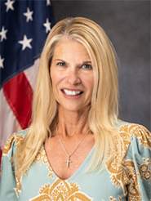
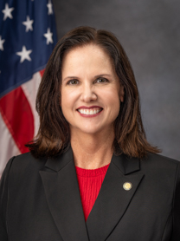
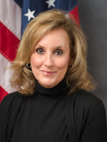
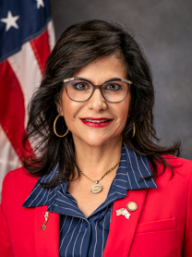
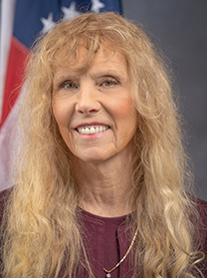
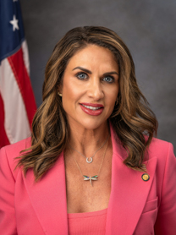
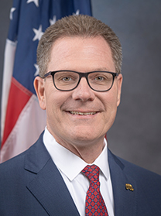
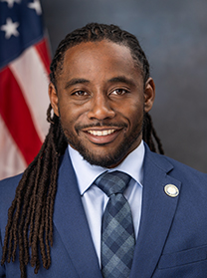
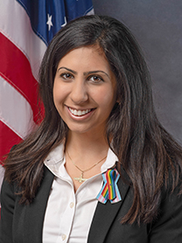
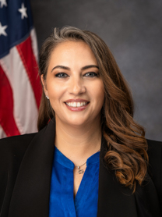
Bill Sponsors
Senator Debbie Mayfield
Representatives
Kim Kendall
Allison Tant
Yvette Benarroch
Peggy Gossett-Seidman
Meg Weinberger
Dean Black
Daryl Campbell
Dr. Anna V. Eskamani
Debra Tendrich

Slide 3
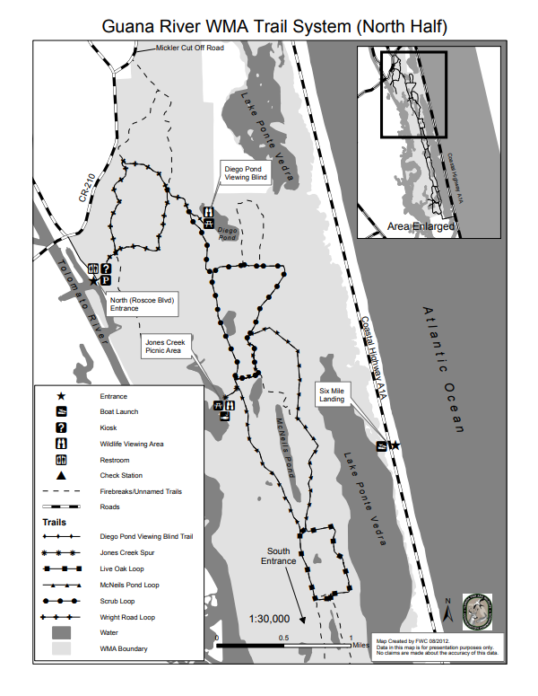
Motivation
Public opposition to a 600 acre land swap in the Guana River Wildlife Management Area
“St. Johns County residents oppose Guana River Wildlife Management Area land swap” (News4JAX, 5/15/2025)
“Conservation groups sound alarm on opaque, fast-tracked Guana River land swap plan” (Florida Politics, 5/17/2025)
“Residents rally against proposed Guana Preserve land swap in St. Johns County” (First Coast News, 5/17/2025)

Slide 4
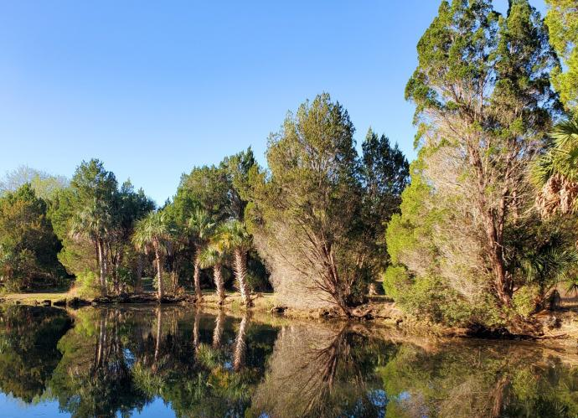
Objectives
Increase transparency
Require 30-day public notice
Post transaction details publicly
Clarify exchange of lands
Justify changes in land use
Crystal River Preserve State Park in Citrus County
Notes:
Increase transparency in the sale or exchange of conservation lands by state agencies and water management districts.
Require at least 30 days’ public notice before any meeting to consider a proposed land sale or exchange.
Ensure important transaction details are posted publicly, including the parcels involved.
Require clarification of which lands would remain protected through permanent conservation easements in an exchange.
Improve public accountability by requiring justification that the land is no longer needed for conservation purposes before disposal or exchange.

Slide 5
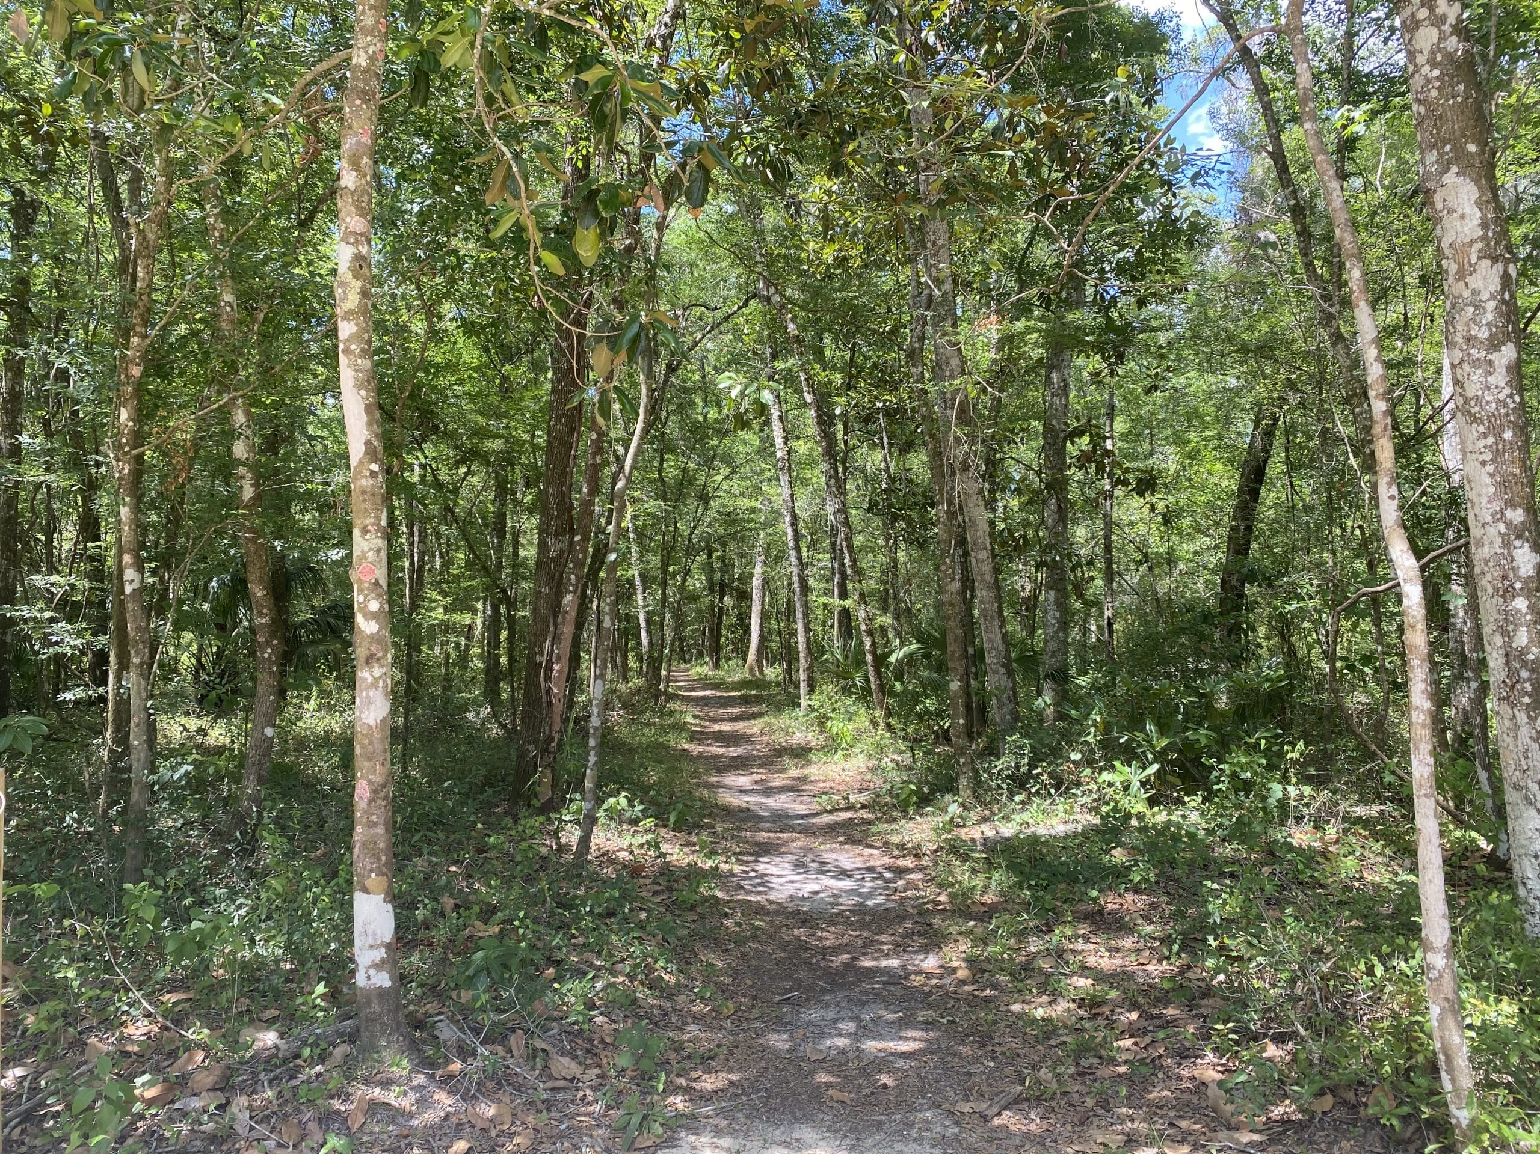
Details
Overview of the Bill
  SB 546 / HB 441 focuses on conservation lands
  Process for selling or exchanging conservation lands
  More transparent and accessible decisions
  State agencies and water management districts
  Public Notice Requirements
  30-day public notice
  Sufficient time to review and respond to proposals
  Publish key details online in advance
  Keep the public informed
Fickett Hammock Preserve in
Hernando County
Notes:
Overview of the Bill
SB 546 / HB 441 focuses on conservation lands in Florida.
The bill addresses how certain public conservation lands may be sold or exchanged.
Its main purpose is to make these decisions more transparent and publicly accessible.
It applies to transactions involving state agencies and water management districts.
Public Notice Requirements
The bill requires at least 30 days of public notice before a meeting on a proposed sale or exchange.
Notice must give the public enough time to review and respond to the proposal.
Key details about the transaction must be made available online in advance.
This helps communities stay informed about possible changes to protected lands.

Slide 6
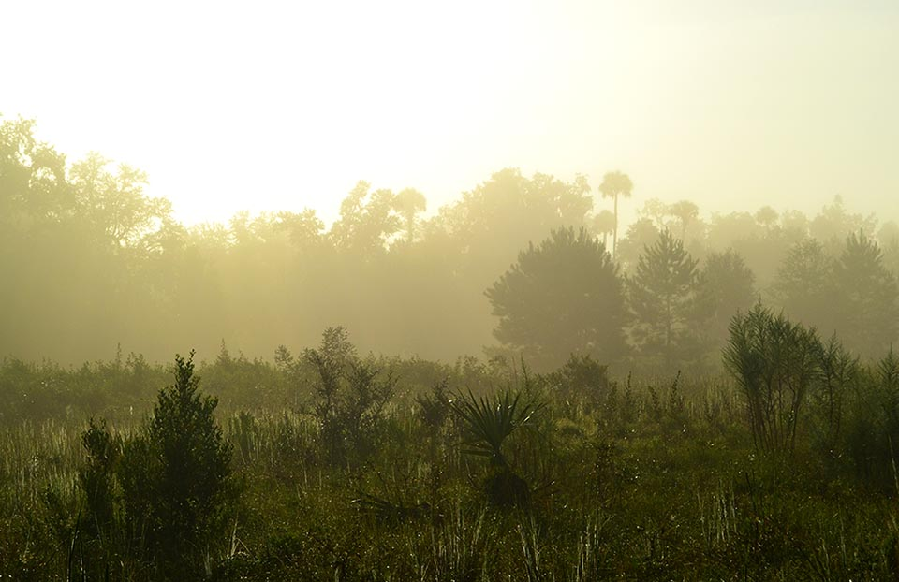
Details
Accountability and Protection
  Reasons for change in land use
  Identification of conservation areas in land exchanges
  More public involvement in conservation land decisions
  Public and justified conservation land decisions
Silver Springs Forest Conservation Area
in Marion County
Notes:
Accountability and Protection
The bill requires an explanation of why the land is no longer needed for conservation purposes.
In land exchanges, it must identify which areas will remain protected by a permanent conservation easement.
The bill strengthens public accountability in decisions about conservation property.
Overall, it aims to ensure that conservation land decisions are made with greater oversight and justification.

Slide 7
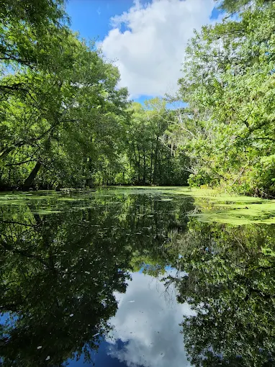
Potential Impacts
Environmental:
Protecting critical ecosystems
Long-term environmental planning
Developers:
Predictability in land use decisions
New development opportunities
Longer approval timelines
Local Governments & Water Management Districts:
Additional administrative responsibilities
More accountability in the decision process
Balance development with environmental protection
Jumper Creek Wildlife Management
Area in Sumter County
Notes:
Environmental:
May improve protection of critical ecosystems through clear conservation safeguards.
Better tracking of conservation land changes can support long-term environmental planning.
Homeowners & Developers:
Increased transparency provides more predictability in land use decisions.
Potential for new development opportunities if land becomes available.
Longer approval timelines due to added public notice and review requirements.
Local Governments & Water Management Districts:
Additional administrative responsibilities for public notice and documentation.
Increased accountability in decision-making processes.
Need to balance development pressures with environmental protection goals.

Slide 8
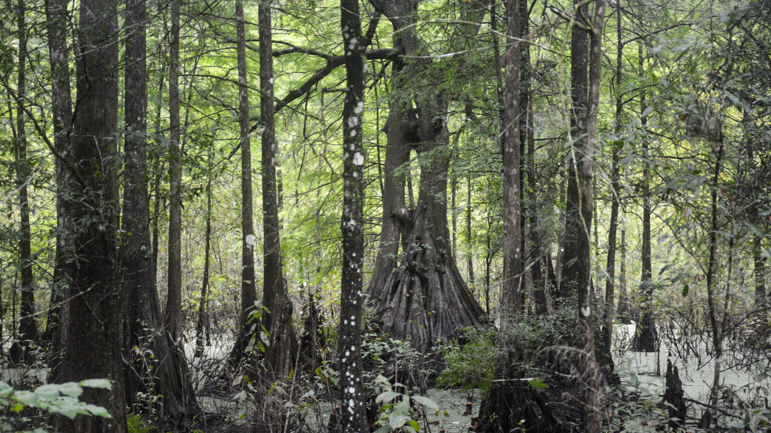
Considerations
Defining land “no longer needed”
Slower project timelines
Conflicts between development and environmental preservation
Enforcement of conservation easements
Political pressure
Cypress Lakes Preserve in Hernando County
Notes:
Determining what qualifies as land “no longer needed” for conservation may be subjective.
Increased transparency could slow down decision-making and project timelines.
Potential conflicts between economic development and environmental preservation.
Ensuring enforcement of conservation easements over time may require additional resources.
Public engagement may influence decisions, but could also introduce political pressure.

Slide 9
bills that passed
Bill Title | SB | HB | Status
Special District Funding | 214 | 273 | Passed 3/6/26, 3/4/26
Data Centers | 484 | 1007 | Approved by the Governor 5/7/2026
Onsite Sewage Treatment and Disposal System | 698 | 589 | Approved by the Governor 5/6/2026
Stormwater Treatment | 848 | 1457 | Approved by the Governor 5/6/2026
Perfluoroalkyl and Polyfluoroalkyl Substances | 1230 | 1019 | Passed 3/4/26, 3/12/26
Claims and Suits Against the Government | 1366 | 145 | Passed 3/10/26, 3/12/26
Utility Services | 1724 | 1451 | Passed 3/13/26, 3/12/26

Slide 10
Thank You

